Slide 1
Design and Analysis of Algorithms
CS602
Lecture 18
Network Flow – III
Analysis of Ford Fulkerson algorithm

Slide 2
Ford Fulkerson algorithm
A simple path based algorithm
+
Residual Network

Slide 3

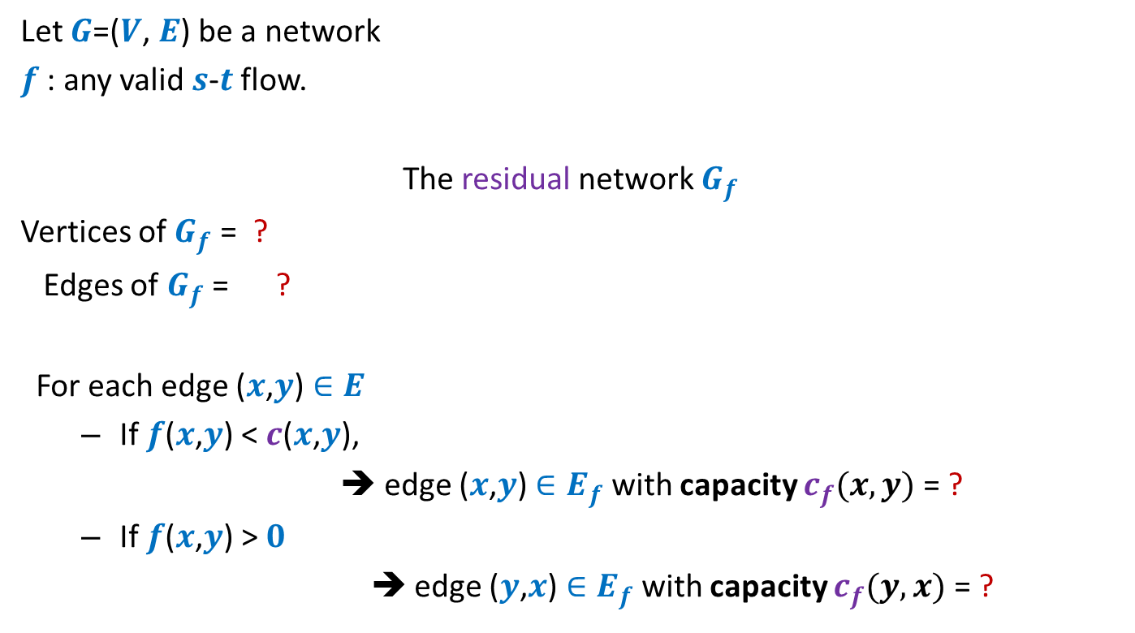



Residual network
Let $G$=($V$, $E$) be a network
$f$ : any valid $s$-$t$ flow.
The residual network $G_{f}$
Vertices of $G_{f}$ = ?
Edges of $G_{f}$ = ?
For each edge ($x$,$y$) $∈E$
If $f$($x$,$y$) < $c$($x$,$y$),
➔ edge ($x$,$y$) $∈E_{f}$ with capacity $c_{f}(x,y)$= ?
If $f$($x$,$y$) > $0$
➔ edge ($y$,$x$) $∈E_{f}$with capacity $c_{f}(y,x)$ = ?
$$V$$
$$E_{f}$$
Forward edge
$c$($x$,$y$) - $f$($x$,$y$)
Backward edge
$f$($x$,$y$)

Slide 4
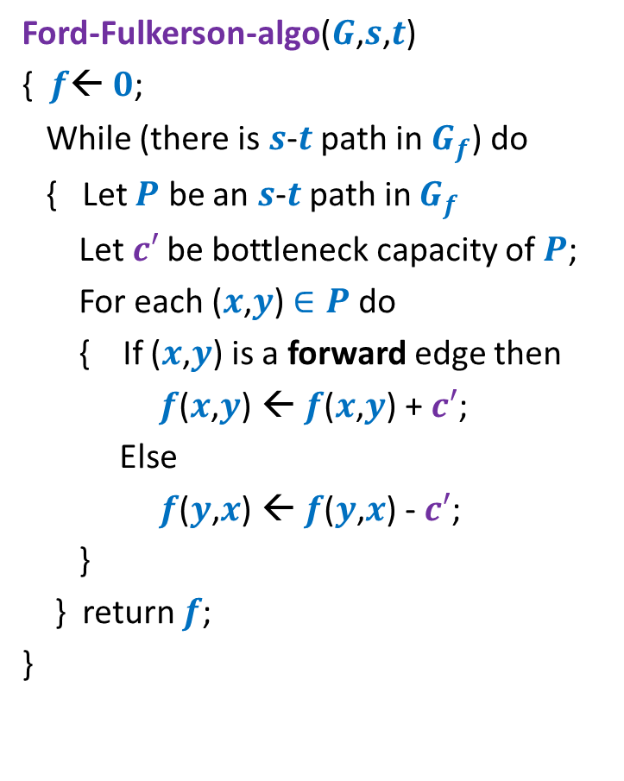
Ford Fulkerson algorithm
Ford-Fulkerson-algo($G$,$s$,$t$)
{ $f$← $0$;
While (there is $s$-$t$ path in $G_{f}$) do
{ Let $P$ be an $s$-$t$ path in $G_{f}$
Let$c′$ be bottleneck capacity of $P$;
For each ($x$,$y$) $∈P$ do
{ If ($x$,$y$) is a forward edge then
$f$($x$,$y$) ← $f$($x$,$y$) + $c′$;
Else
$f$($y$,$x$) ← $f$($y$,$x$) - $c′$;
}
} return $f$;
}
Correctness of the algorithm ?

Slide 5










Correctness ?
Suppose Output of FF algorithm = $19$
$$x$$
Is $19$ the max flow ?
10
3
9
14
$$s$$
$$t$$
$$≤27$$
8
$$u$$
2
$$v$$
10
$≤2$5
3
3
1
9
$$y$$
Flow can not exceed the sum of the capacities of these edges.
Flow can not exceed the sum of the capacities of these edges.

Slide 6


Correctness ?
Suppose Output of FF algorithm = $19$
$$x$$
Is $19$ the max flow ?
10
3
9
14
$$s$$
$$t$$
$$≤27$$
8
$$u$$
2
$$v$$
10
$≤2$5
3
3
1
9
$$≤37$$
$≤19$ ☺
$$y$$
We need a tool to formalize this intuition.
Flow can not exceed the sum of the capacities of these edges.
Flow can not exceed the sum of the capacities of these edges.

Slide 7

$s$-$t$Cuts

Slide 8







$s$-$t$cut
$A⊂V$, with
$s∈A$, $t∈\overline{A}$
$$s$$
$$t$$
$$A$$
$$\overline{A}$$
$$G$$

Slide 9
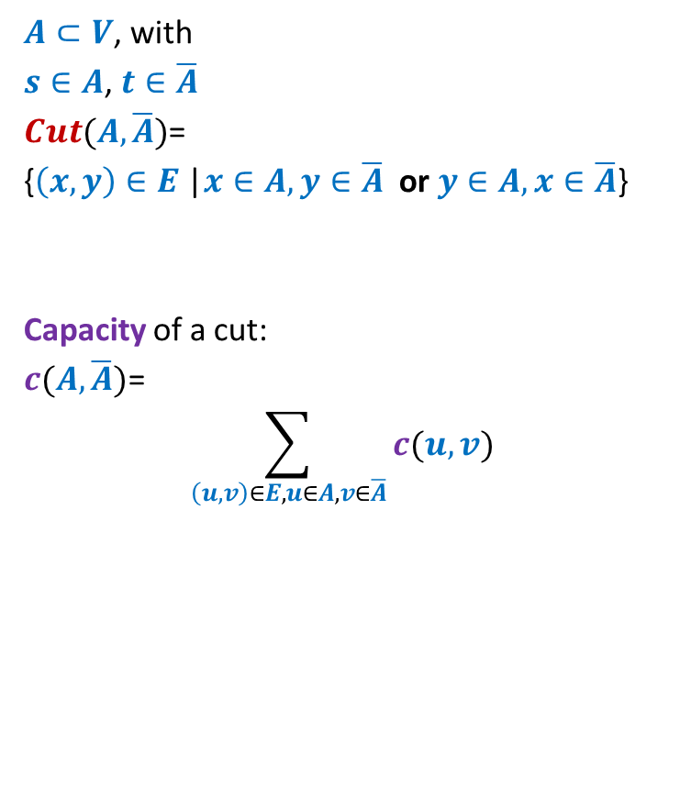
$s$-$t$cut
$A⊂V$, with
$s∈A$, $t∈\overline{A}$
$Cut(A,\overline{A})$=
{$\left(x,y\right)∈E$ |$x∈A,y∈\overline{A}$ or $y∈A,x∈\overline{A}$}
Capacity of a cut:
$c(A,\overline{A})$=
$$\sum_{\left(u,v\right)∈E,u∈A, v∈\overline{A}}{c(u,v)}$$
$$s$$
$$t$$
$$A$$
$$\overline{A}$$
$$G$$
Note: capacity of only outgoing edges is considered in capacity of a cut.

Slide 10
Cuts and Flows

Slide 11







Useful Generalizations
conservation constraint:
For each vertex $u∈V\backslash \{s,t\}$
Mathematically,
$$\sum_{\left(z,u\right) ∈ E}{f\text{(}z\text{,}u\text{)}}=\sum_{ \left(u,v\right) ∈ E }{f\text{(}u},v)$$
Lemma: $f_{out}\left(u\right)−f_{in}(u)$ =
$$f_{in}(u)$$
$$f_{out}(u)$$
$$u$$
$$f_{in}(u)$$
$$f_{out}(u)$$
0 if $u∈V\backslash \{s,t\}$
$value(f)$ if $u=s$
$−value(f)$ if $u=t$

Slide 12



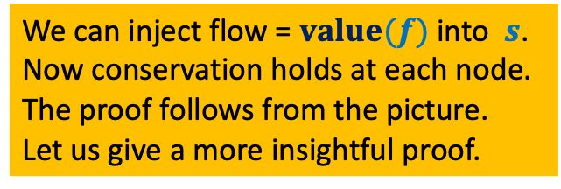
Useful Generalizations
Consider any valid flow $f$.
Question: How would you define $f_{out}\left(A\right)$ ?
$$f_{out}\left(A\right)=\sum_{\left(x,y\right) ∈ E, x∈A,y∈\overline{A}}{f\text{(}x,y\text{)}}$$
$$f_{in}\left(A\right)=\sum_{\left(x,y\right) ∈ E, y∈A,x∈\overline{A}}{f\text{(}x,y\text{)}}$$
Question: What would be $f_{out}\left(A\right)−f_{in}\left(A\right)$ ?
Answer: $value(f)$
Proof ?
$$s$$
$$A$$
We can inject flow = $value(f)$ into $s$.
Now conservation holds at each node.
The proof follows from the picture.
Let us give a more insightful proof.

Slide 13
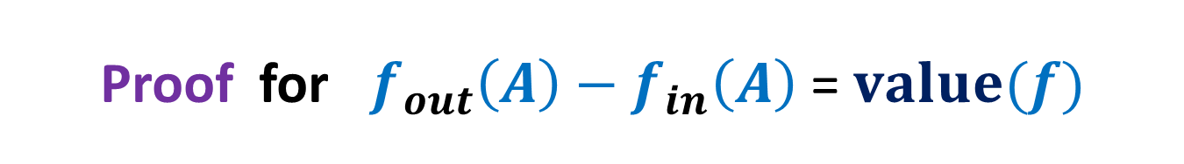


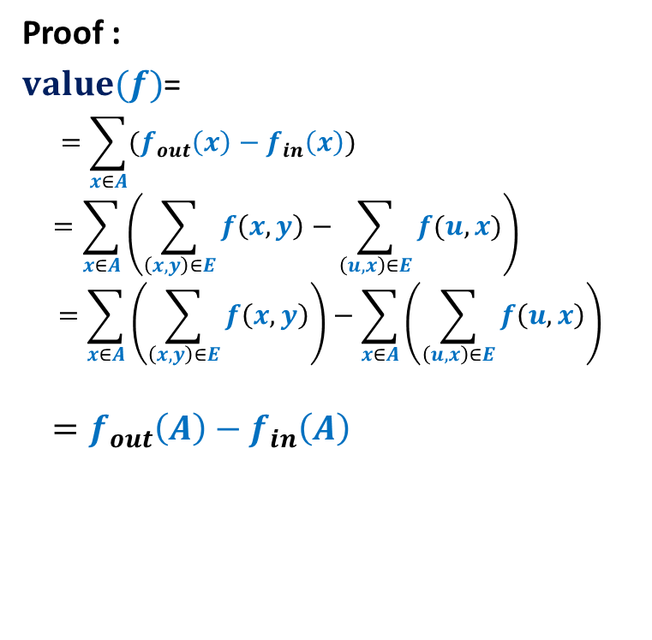

Proof for $f_{out}\left(A\right)−f_{in}\left(A\right)$ = $value(f)$
Consider any valid flow $f$.
Proof :
$value(f)$=
$$=\sum_{x∈A}{(f_{out}\left(x\right)−f_{in}\left(x\right))}$$
$$=\sum_{x∈A}{\left(\sum_{\left(x,y\right)∈E}{f\left(x,y\right)}−\sum_{\left(u,x\right)∈E}{f(u,x)}\right)}$$
$$=\sum_{x∈A}{\left(\sum_{\left(x,y\right)∈E}{f\left(x,y\right)}\right)}−\sum_{x∈A}{\left(\sum_{\left(u,x\right)∈E}{f\left(u,x\right)}\right)}$$
$$=f_{out}\left(A\right)−f_{in}\left(A\right)$$
$$f_{out}\left(s\right)−f_{in}\left(s\right)$$
?
$$x$$
$$s$$
$$v$$
$$A$$

Slide 14
A simple Relation
between Flows and capacity of cuts

Slide 15

Flows and capacity of cuts
Consider any valid flow $f$.
Lemma: $f_{out}\left(A\right)−f_{in}\left(A\right)≤c(A,\overline{A})$.
Proof:
$f_{out}\left(A\right)−f_{in}\left(A\right)≤f_{out}\left(A\right)$
$$=\sum_{\left(u,v\right)∈E,u∈A, v∈\overline{A}}{f(u,v)}$$
$$≤\sum_{\left(u,v\right)∈E,u∈A, v∈\overline{A}}{c(u,v)}$$
$=c(A,\overline{A})\text{.}$
Theorem: the maximum value of $s$-$t$flow is
bounded by the capacity of every $s$-$t$cut.
$$s$$
$$t$$
$$A$$
$$\overline{A}$$
$$G$$

Slide 16
A deep Relation
between Flows and capacity of cuts

Slide 17

Max-Flow Min-Cut Theorem
Theorem: the maximum value of $s$-$t$flow is equal to the capacity of min $s$-$t$cut.
It may appear strange.
How can an algorithm whose correctness we have not established prove a
theorem ?
Proof is based on
Ford Fulkerson Algorithm

Slide 18
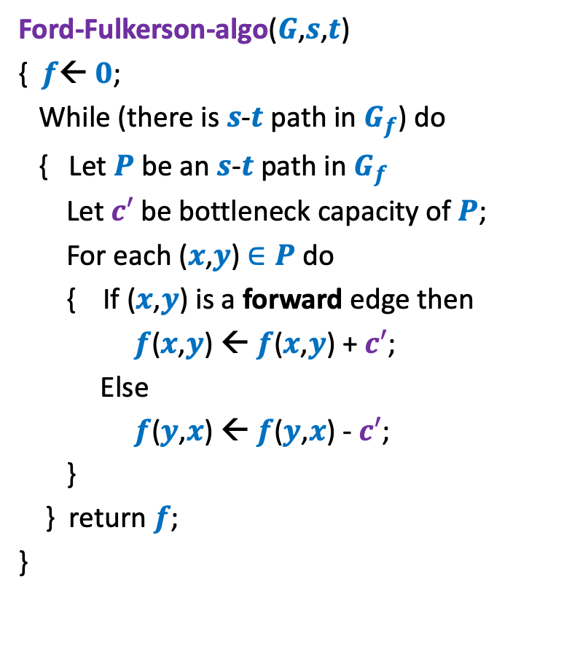
Ford Fulkerson algorithm
Ford-Fulkerson-algo($G$,$s$,$t$)
{ $f$← $0$;
While (there is $s$-$t$ path in $G_{f}$) do
{ Let $P$ be an $s$-$t$ path in $G_{f}$
Let$c′$ be bottleneck capacity of $P$;
For each ($x$,$y$) $∈P$ do
{ If ($x$,$y$) is a forward edge then
$f$($x$,$y$) ← $f$($x$,$y$) + $c′$;
Else
$f$($y$,$x$) ← $f$($y$,$x$) - $c′$;
}
} return $f$;
}
The proof of the theorem
as well as correctness of algorithm
will be achieved simultaneously.
Amazing !!
Correctness of the algorithm
Think over it for a few minutes before proceeding further.

Slide 19
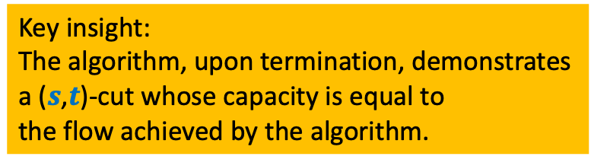
Ford Fulkerson algorithm
Ford-Fulkerson-algo($G$,$s$,$t$)
{ $f$← $0$;
While (there is $s$-$t$ path in $G_{f}$) do
{ Let $P$ be an $s$-$t$ path in $G_{f}$
Let$c′$ be bottleneck capacity of $P$;
For each ($x$,$y$) $∈P$ do
{ If ($x$,$y$) is a forward edge then
$f$($x$,$y$) ← $f$($x$,$y$) + $c′$;
Else
$f$($y$,$x$) ← $f$($y$,$x$) - $c′$;
}
} return $f$;
}
Key insight:
The algorithm, upon termination, demonstrates
a ($s$,$t$)-cut whose capacity is equal to
the flow achieved by the algorithm.
Which is this cut defined naturally after the termination of Ford Fulkerson algorithm?

Slide 20










Proof of max-flow min-cut Theorem
How does $G_{f}$ look like ?
$f$ : flow computed by Ford-Fulkerson algorithm.
$A$: set of vertices reachable from $s$ in $G_{f}$
Claim: $value(f)$ = $c(A,\overline{A})$.
$$s$$
$$t$$
$$s$$
$$t$$
$$A$$
$$\overline{A}$$
$$A$$
$$\overline{A}$$
$$G$$
$$G_{f}$$

Slide 21
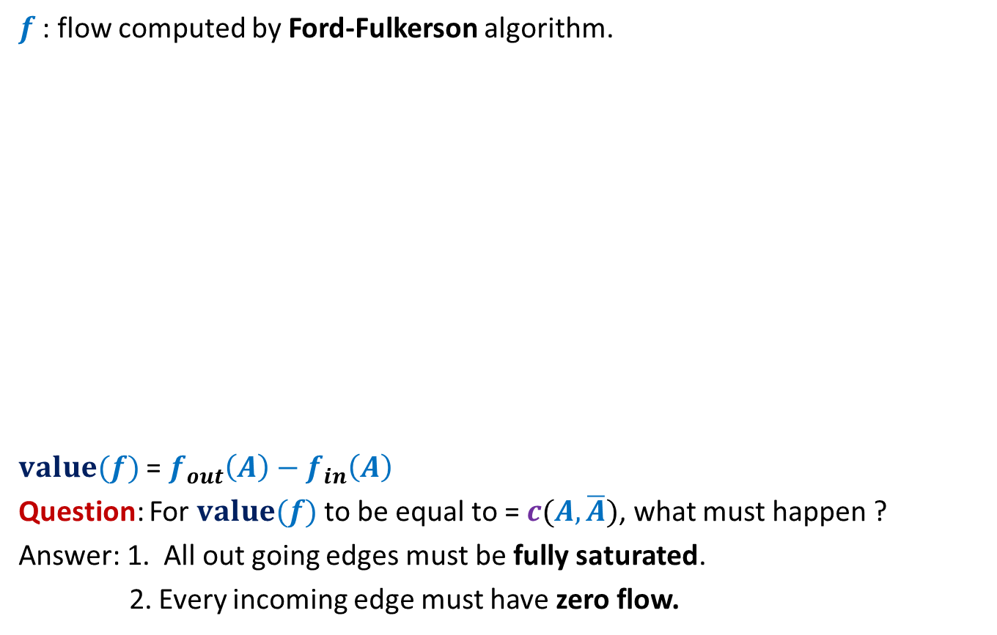
Proof of max-flow min-cut Theorem
$f$ : flow computed by Ford-Fulkerson algorithm.
$value(f)$ = $f_{out}\left(A\right)−f_{in}\left(A\right)$
Question: For $value(f)$ to be equal to = $c(A,\overline{A})$, what must happen ?
Answer: 1. All out going edges must be fully saturated.
2. Every incoming edge must have zero flow.
$$s$$
$$t$$
$$s$$
$$t$$
$$A$$
$$\overline{A}$$
$$A$$
$$\overline{A}$$
$$G$$
$$G_{f}$$
How will you show this ?

Slide 22


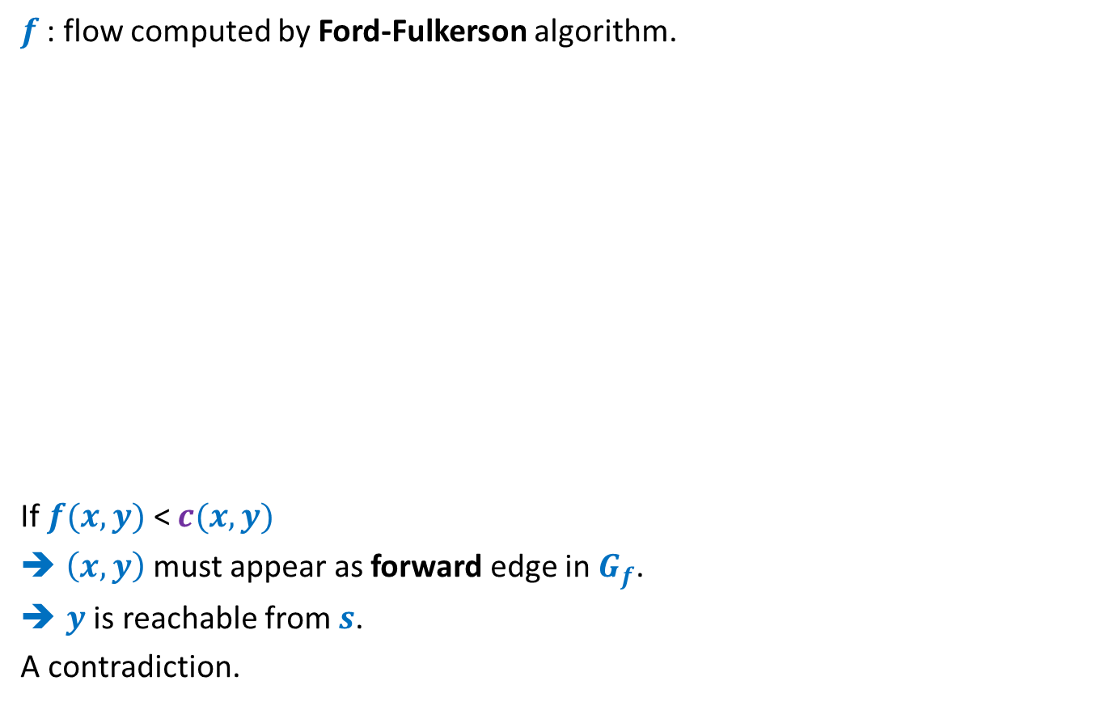


Proof of max-flow min-cut Theorem
$f$ : flow computed by Ford-Fulkerson algorithm.
If $f(x,y)$ < $c(x,y)$
$\left(x,y\right)$ must appear as forward edge in$G_{f}$.
$y$ is reachable from $s$.
A contradiction.
$$x$$
$$x$$
$$s$$
$$y$$
$$t$$
$$s$$
$$y$$
$$t$$
$$A$$
$$\overline{A}$$
$$A$$
$$\overline{A}$$
$$G$$
$$G_{f}$$

Slide 23


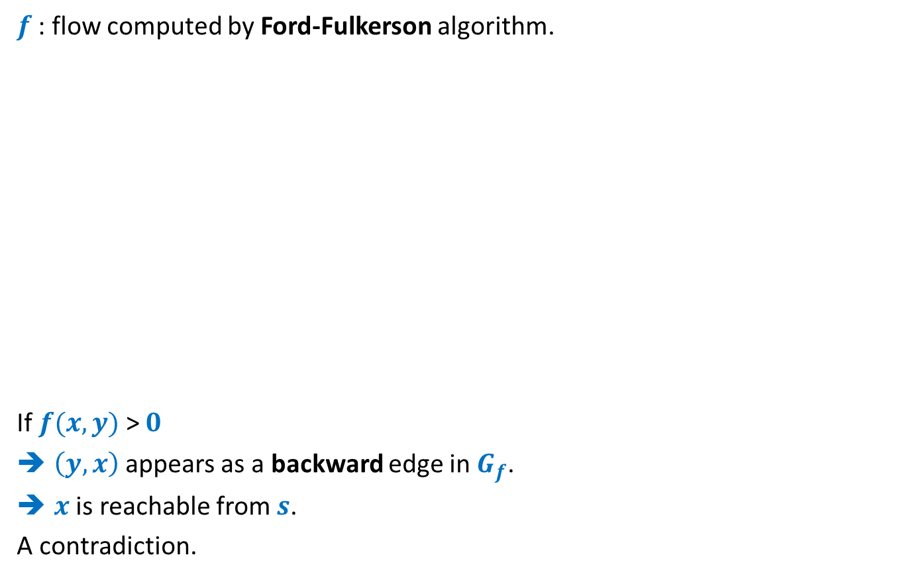


Proof of max-flow min-cut Theorem
$f$ : flow computed by Ford-Fulkerson algorithm.
If $f(x,y)$ > $0$
$\left(y,x\right)$appears as a backward edge in $G_{f}$.
$x$ is reachable from $s$.
A contradiction.
$$s$$
$$x$$
$$s$$
$$x$$
$$t$$
$$t$$
$$y$$
$$y$$
$$A$$
$$\overline{A}$$
$$A$$
$$\overline{A}$$
$$G$$
$$G_{f}$$

Slide 24
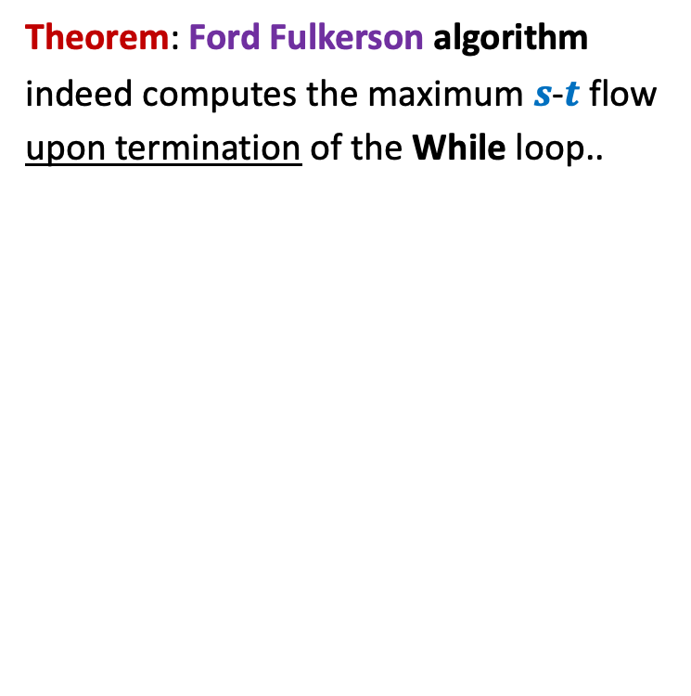
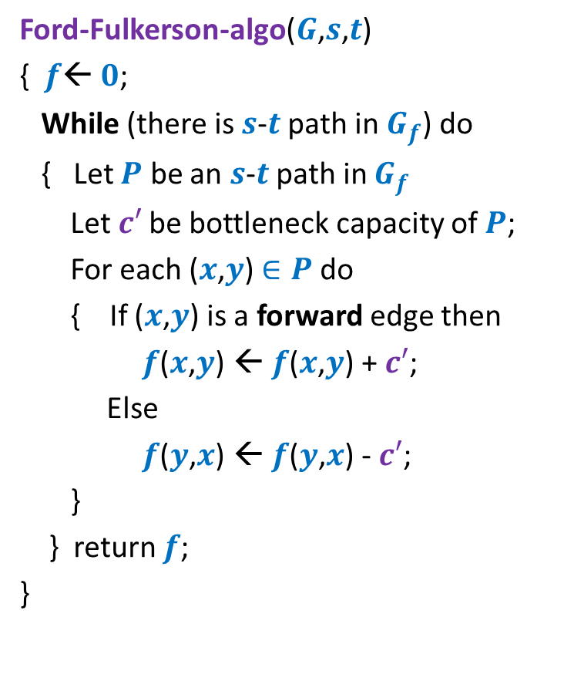
Ford Fulkerson algorithm
Ford-Fulkerson-algo($G$,$s$,$t$)
{ $f$← $0$;
While (there is $s$-$t$ path in $G_{f}$) do
{ Let $P$ be an $s$-$t$ path in $G_{f}$
Let$c′$ be bottleneck capacity of $P$;
For each ($x$,$y$) $∈P$ do
{ If ($x$,$y$) is a forward edge then
$f$($x$,$y$) ← $f$($x$,$y$) + $c′$;
Else
$f$($y$,$x$) ← $f$($y$,$x$) - $c′$;
}
} return $f$;
}
Theorem: Ford Fulkerson algorithm
indeed computes the maximum $s$-$t$ flow
upon termination of the While loop..

Slide 25
Integrality of max-flow
A useful tool for many applications of Max-Flow

Slide 26

Integrality of max-flow
Theorem: Given a network $G$=($V$,$E$), and two vertices $s$,$t∈V$,
if edge capacities are integers, then there exists a maximum $s$-$t$flow $f$
which is “integral”.
$f\left(e\right)∈Z$for each $e∈E$
1
.67
1
.67
1
1
1
$$s$$
1
.33
$$t$$
0
.33
0
1
1

Slide 27
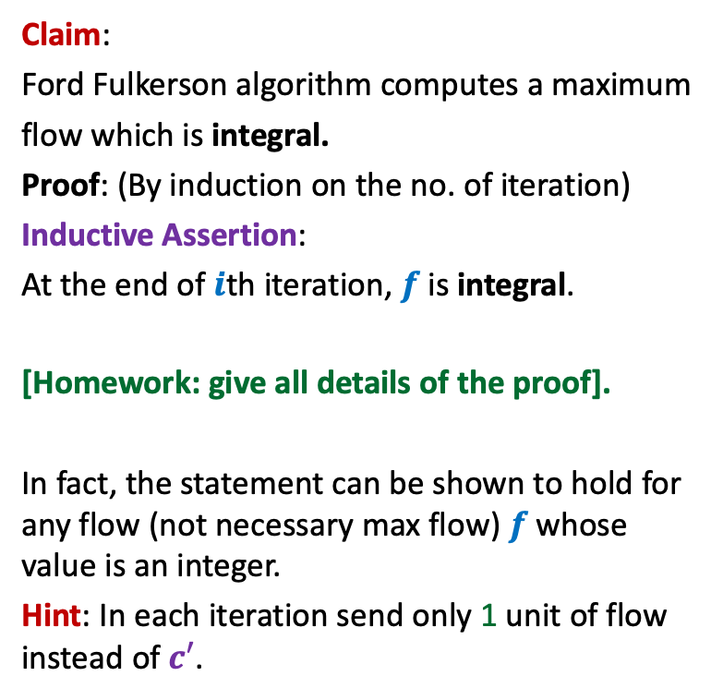
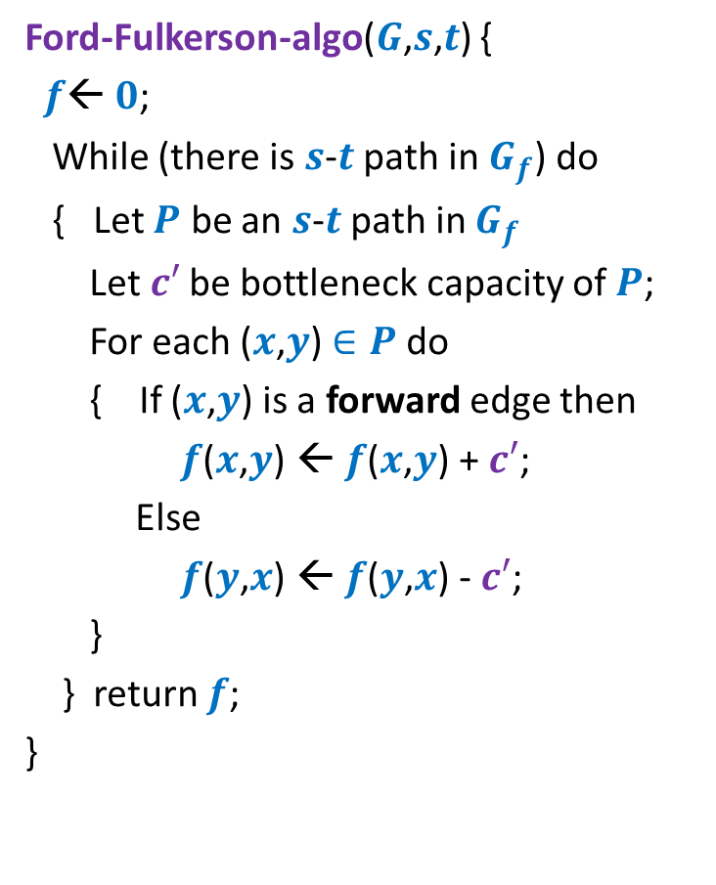
Proof for Integrality theorem
Ford-Fulkerson-algo($G$,$s$,$t$) {
$f$← $0$;
While (there is $s$-$t$ path in $G_{f}$) do
{ Let $P$ be an $s$-$t$ path in $G_{f}$
Let$c′$ be bottleneck capacity of $P$;
For each ($x$,$y$) $∈P$ do
{ If ($x$,$y$) is a forward edge then
$f$($x$,$y$) ← $f$($x$,$y$) + $c′$;
Else
$f$($y$,$x$) ← $f$($y$,$x$) - $c′$;
}
} return $f$;
}
Claim:
Ford Fulkerson algorithm computes a maximum
flow which is integral.
Proof: (By induction on the no. of iteration)
Inductive Assertion:
At the end of $i$th iteration, $f$ is integral.
[Homework: give all details of the proof].
In fact, the statement can be shown to hold for any flow (not necessary max flow) $f$whose value is an integer.
Hint: In each iteration send only 1 unit of flow instead of $c′$.

Slide 28


Ford Fulkerson algorithm
$P$ is any $s$-$t$ path
Ford-Fulkerson-algo($G$,$s$,$t$)
{ $f$← $0$;
While (there is $s$-$t$ path in $G_{f}$) do
{ Let $P$ be an $s$-$t$ path in $G_{f}$
Let$c′$ be bottleneck capacity of $P$;
For each ($x$,$y$) $∈P$ do
{ If ($x$,$y$) is a forward edge then
$f$($x$,$y$) ← $f$($x$,$y$) + $c′$;
Else
$f$($y$,$x$) ← $f$($y$,$x$) - $c′$;
}
} return $f$;
}
Adversary can exploit this fact to his/her
advantage to increase the no. of iterations.
Results:
Edge capacities are real numbers:
Number of iterations:
Edge capacities Integral :
Exponential no. of iterations
$$∞$$

Slide 29


A worst case example for networks with integer edge weights
$$G$$
$$G_{f}$$
$$x$$
$$x$$
1
1000
1000
1000
1000
$$s$$
1
1
$$t$$
$$s$$
1
$$t$$
1
1000
1000
1000
1000
$$y$$
$$y$$

Slide 30
A worst case example for networks with integer edge weights
$$G$$
$$G_{f}$$
$$x$$
$$x$$
1
1
1
1000
999
1000
1000
$$s$$
1
1
$$t$$
$$s$$
1
$$t$$
1
1
1000
1000
1000
999
1
$$y$$
$$y$$

Slide 31
A worst case example for networks with integer edge weights
$$G$$
$$G_{f}$$
$$x$$
$$x$$
1
1
1
1
2
1000
999
1000
999
$$s$$
1
1
$$t$$
$$s$$
1
$$t$$
1
2
1
1000
1000
999
999
1
1
$$y$$
$$y$$
The algorithm will run for 2000 iterations to compute max-flow !

Slide 32

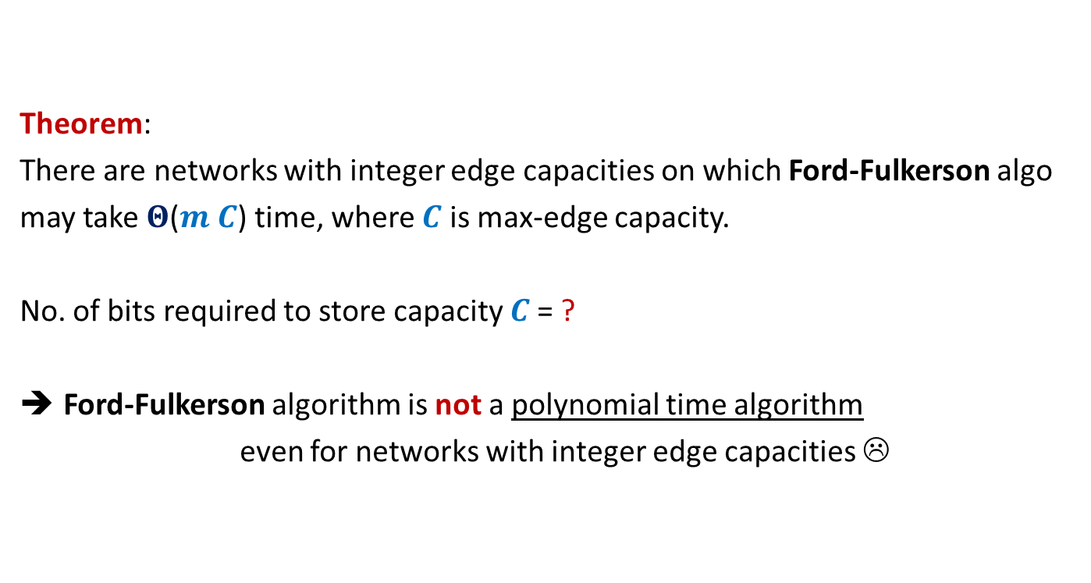
Theorem:
There are networks with integer edge capacities on which Ford-Fulkerson algo
may take $Θ$($m C$) time, where $C$ is max-edge capacity.
No. of bits required to store capacity $C$= ?
Ford-Fulkerson algorithm is not a polynomial time algorithm
even for networks with integer edge capacities ☹
$$\log_{2}C$$

Slide 33

Polynomial time algorithms for Max-Flow
A natural question: How to achieve polynomial running time ?
Looking at the example 2 slides back, how should we pick path $P$ ?
➔
A natural idea:
Select the path of maximum capacity.
select the paths in Ford-Fulkerson algorithm cleverly

Slide 34
Polynomial Time algorithms for max-flow
Algorithm 1 For Networks with integer capacities

Slide 35


Algorithm 1
Algorithm-1($G$,$s$,$t$) {
Ford-Fulkerson-algo($G$,$s$,$t$) {
$f$← $0$;
While (there is $s$-$t$ path in $G_{f}$) do
{ Let $P$ be an $s$-$t$ path in $G_{f}$
Let$c′$ be bottleneck capacity of $P$;
For each ($x$,$y$) $∈P$ do
{ If ($x$,$y$) is a forward edge then
$f$($x$,$y$) ← $f$($x$,$y$) + $c′$;
Else
$f$($y$,$x$) ← $f$($y$,$x$) - $c′$;
}
} return $f$;
}
Worked out Assignment 3
Insight from
MaxFlow-MinCut Theorem.
Let $P$ be the max-capacity $s$-$t$ path in $G_{f}$;

Slide 36
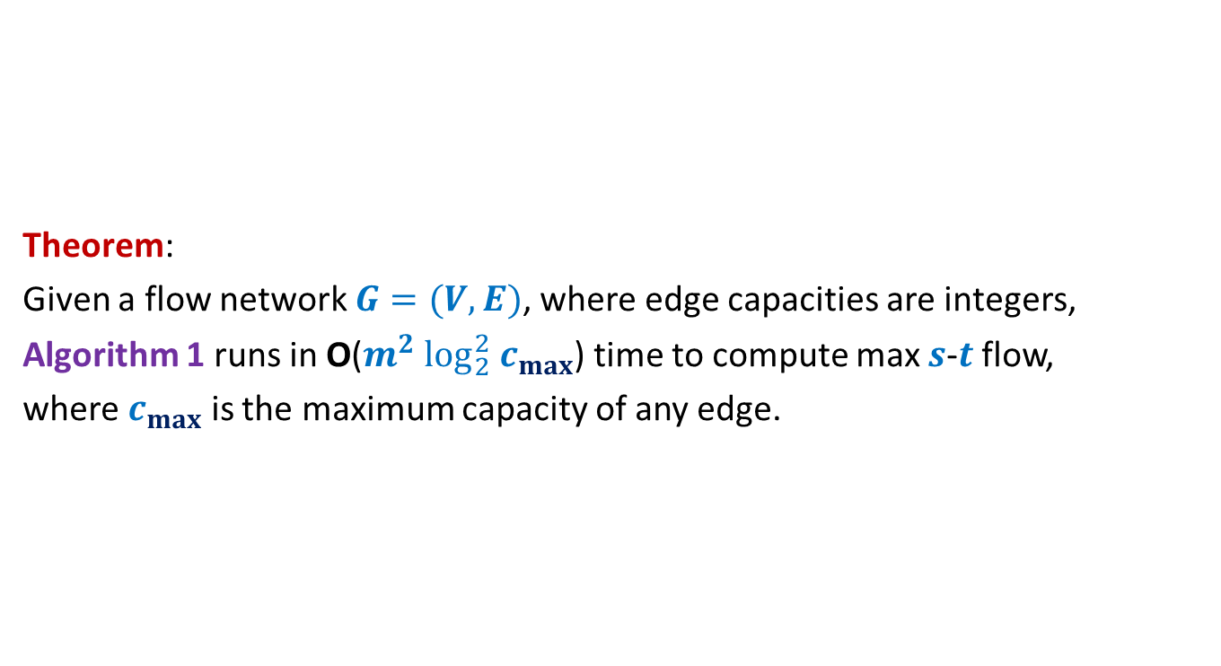
Algorithm 1
Theorem:
Given a flow network $G=(V,E)$, where edge capacities are integers,
Algorithm 1 runs in O($m^{2} \log_{2}^{2} c_{max}$) time to compute max $s$-$t$ flow,
where $c_{max}$ is the maximum capacity of any edge.

